Slide 1

Monte Carlo Evaluation of Trading Systems

Slide 2

What is Automated Trading System?

Slide 3
How to test the Performance?
T-Test
Boot Strap Test
Monte Carlo Permutation Test

Slide 4

Weakness of Bootstrap Test
Assumption that the empirical distribution of the obtained sample is representative of the population distribution.

Slide 5
Monte-Carlo permutation simulation
Reveals the permutation-null-hypothesis distribution of nearly any reasonable test statistic
It can do so to whatever accuracy is desired
Limited only by available computational resources.
The test’s dependence on the distribution of the obtained sample is greatly reduced compared to the bootstrap

Slide 6
The Permutation Principle
Suppose we have a scalar-valued function of a vector. We’ll call this g(v).
In a market-trading scenario, v would be the vector of market changes and g(.) would be a performance measure for our trading system.
Then v is the vector of next-day market changes that we encountered, and g(v) is a measure of our performance over the entire test period. This may be our total return, percent return, Sharpe Ratio, or any other reasonable performance figure.

Slide 7
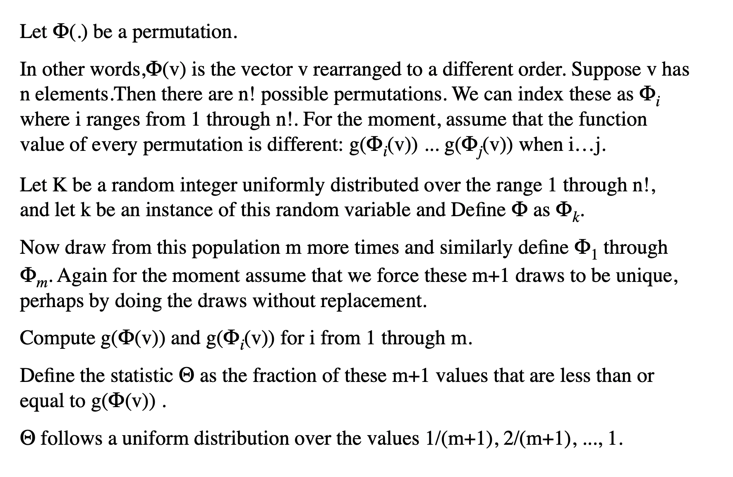

Slide 8

The Trading Scenario

Slide 9

What is a trading opportunity?
At the end of each day you perform some calculations and decide what position you will take the next day. If you choose to enter the market, you open the position when the market opens the next morning.
Every time a defined event occurs, such as the market retreating two percent from its ten-day high, you perform your entry calculations and act accordingly.
You might choose to close the position after a predefined time period (such as one day) elapses.
You might choose to close the position after a predefined market move (such as two points up or down) occurs.

Slide 10
Contd…
The Monte-Carlo simulation presented here does not test the impact of the definition of a trading opportunity.
It tests the quality of the model that chooses to be long, short, or neutral when the trading opportunity arises.

Slide 11
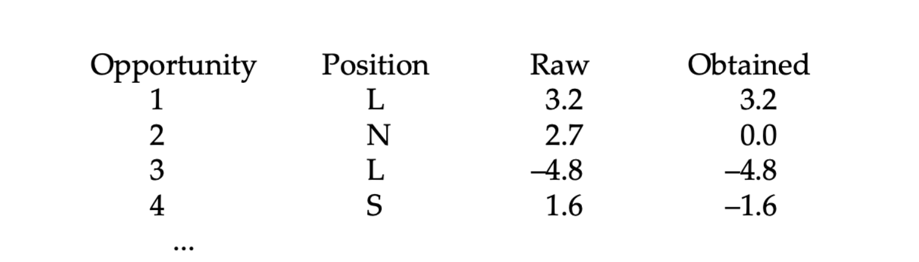
Trading Example

Slide 12

What We Test Versus What We Want To Test

Slide 13
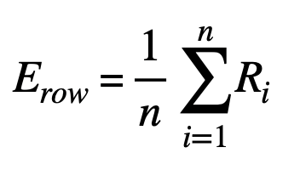
Method for Comparing Bootstrap and Monte Carlo Permutation Simulation
The expected value of a single raw return drawn from the population is, by definition, the mean of these returns.
Raw market returns are Ri for i=1, ..., n.

Slide 14
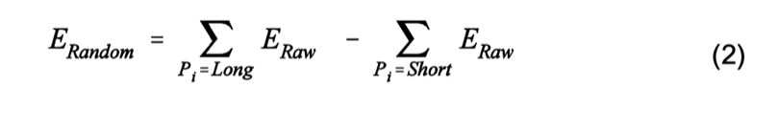
Contd…
Let Pi signify the position of a trading system at opportunity i. This will be long, short, or neutral. The expected return of a trading system in which raw returns are randomly paired with positions is shown in Equation

Slide 15
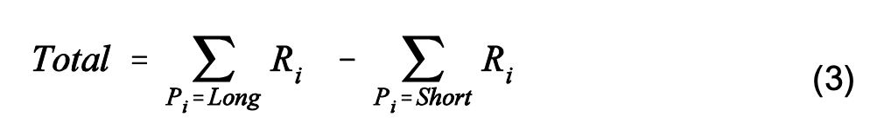
Contd…
The total return of the candidate system is the sum of the raw returns at those times when the candidate system is long, minus the sum of the raw returns when the system is short.

Slide 16
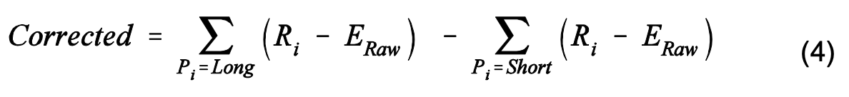
Contd…
The total return of the candidate system is corrected for long/short prejudice by subtracting the expectation of a similarly prejudiced random system.

Slide 17
Assumptions
Non-stationarity
Serial Dependence
Thin Position Vectors
Avoid Using a Generic Null Distribution

Slide 18
When Are We Unable To Use a Monte-Carlo Test?

Slide 19
Code for Monte-Carlo Randomization
At the center of an efficient Monte-Carlo randomization test is an algorithm that can quickly shuffle an array in such a way that every possible permutation is equally likely. The following algorithm fits the bill. Let the array be X1, X2, ..., Xn. Then:
Set i=n.
Randomly choose j from 1, ..., i with all choices being equally likely.
Exchange Xi with Xj.
Set i=i–1.
If i>1gotoStep2.

Slide 20

Tests With Simulated Returns

Slide 21
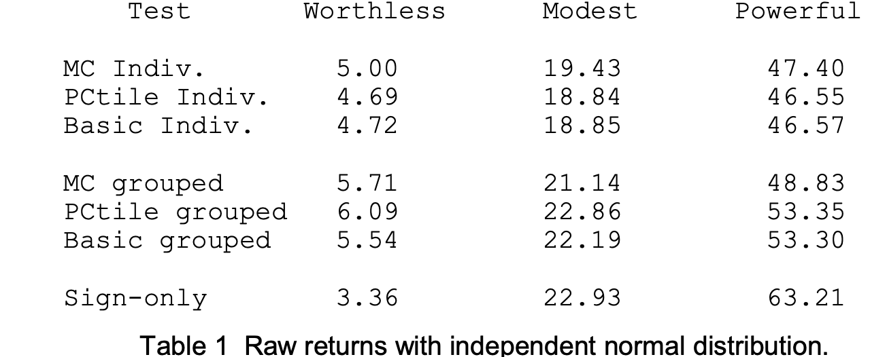
Raw returns with Independent Normal Distribution.

Slide 22

Thank you

